Slide 1
DELIVERY & TEAM
PERFORMANCE ANALYSIS
SQL Data Analytics Project
Presented by SHAIBU BASHIRU
October 2026

Slide 2
Executive Summary
A management view of sales workload, profitability and delivery performance
406
Total orders
3.2 days
Average delivery
3.0 days
Median delivery
10 days
Longest delivery
Lagos carries the largest order volume, indicating the strongest concentration of operational activity.
Sales-representative performance varies materially in both order volume and financial contribution.
Revenue leadership and order-volume leadership are not necessarily held by the same representative.
Delivery performance is relatively stable overall, but the 1–10 day range shows room to improve consistency.
Delivery & Team Performance Analysis • SQL Project 2

Slide 3
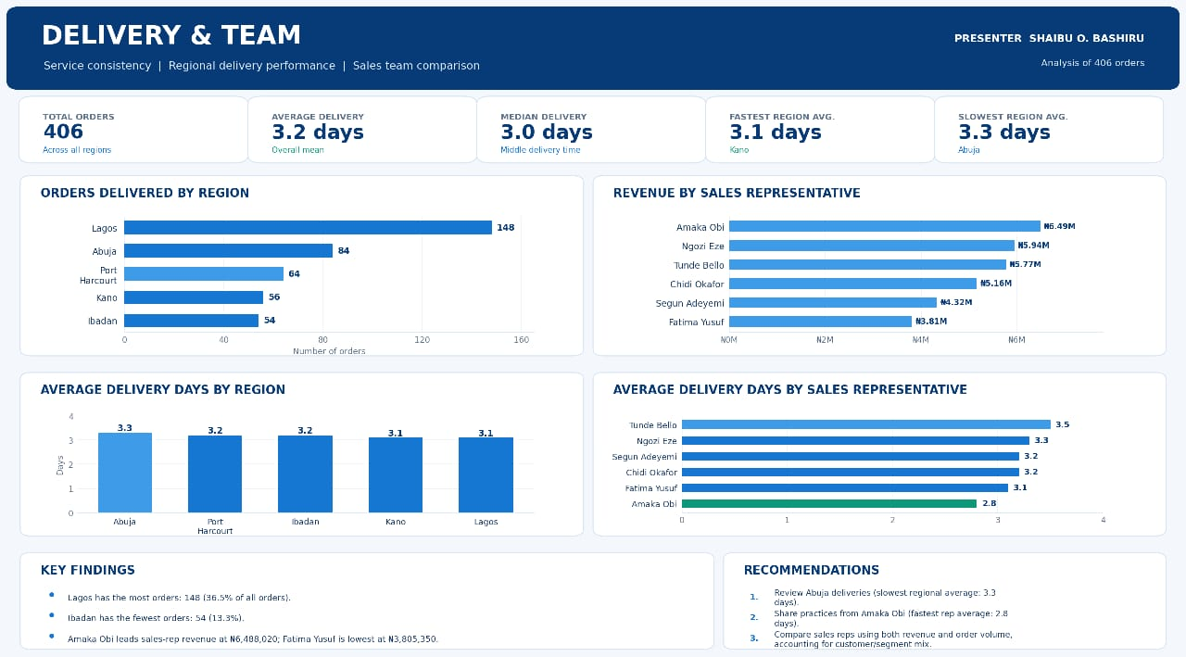

Slide 4
Order Distribution by Region
Where the workload is concentrated
Lagos accounts for 148 orders, well ahead of the other regions.
Abuja is the second-largest market with 84 orders.
Port Harcourt, Kano and Ibadan form the next tier of activity.
Resource planning should reflect the heavier operational demand in Lagos.
Delivery & Team Performance Analysis • SQL Project 3

Slide 5
Sales Representative Performance
Order volume and revenue leadership
Amaka Obi leads revenue at approximately ₦6.49m.
Ngozi Eze handles the highest order volume at 84 orders.
This distinction shows why volume alone is not enough to evaluate sales performance.
Management should assess both commercial value and workload when comparing representatives.
Delivery & Team Performance Analysis • SQL Project 4

Slide 6
Delivery Performance by Region
Average delivery time across operating markets
Average delivery times are tightly grouped around 3 days.
Port Harcourt is marginally slower at 3.3 days.
Lagos and Ibadan record the lowest regional averages at about 3.1 days.
The small spread suggests a broadly consistent delivery process across regions.
Delivery & Team Performance Analysis • SQL Project 5

Slide 7
Delivery Consistency
Speed versus predictability
1 day
Minimum delivery
10 days
Maximum delivery
3.2 days
Mean
3.0 days
Median
The mean and median are close, indicating that the typical delivery experience is around three days.
The 1–10 day range indicates that some orders take substantially longer than the norm.
The management priority should be reducing long-tail delays without sacrificing the current average performance.
Track delivery variation by representative and region to identify operational causes.
Delivery & Team Performance Analysis • SQL Project 6

Slide 8
Key Findings
What the analysis tells management
01
Workload concentration
Lagos is the dominant region by order volume.
02
Revenue leadership
Amaka Obi leads revenue, while Ngozi Eze leads order volume.
03
Delivery stability
Typical delivery performance is around three days.
04
Operational risk
The 1–10 day delivery range points to a long-tail delay problem.
Delivery & Team Performance Analysis • SQL Project 8

Slide 9
Management Recommendations
Actions linked directly to the findings
1
Prioritise regional capacity
Align delivery resources and stock availability with high-volume markets, especially Lagos.
2
Balance volume and value
Evaluate representatives using both order volume and revenue/profit contribution.
3
Investigate long-tail delays
Review the causes of 7–10 day deliveries and establish corrective actions.
4
Monitor mix performance
Track representative performance by segment and category to identify profitable growth opportunities.
Delivery & Team Performance Analysis • SQL Project 9

Slide 10
CONCLUSION
The analysis provides a practical view of sales workload, commercial contribution and delivery performance.
Thank you
Questions & Discussion

